Slide 1
Digital Image Processing
Lecture 07
Image Enhancement-II
(Histogram Processing)

Slide 2
A Note About Grey Levels
So far when we have spoken about image grey level values we have said they are in the range [0, 255]
  Where 0 is black and 255 is white
There is no reason why we have to use this range
  The range [0,255] stems from display
For many of the image processing operations in this lecture grey levels are assumed to be given in the range [0.0, 1.0]

Slide 3
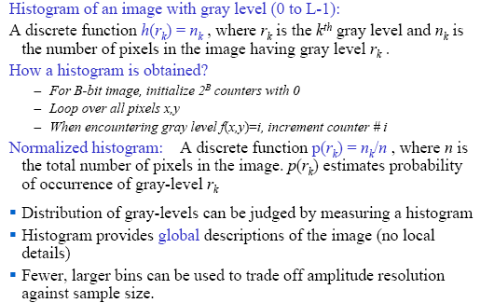
Image Histograms

Slide 4
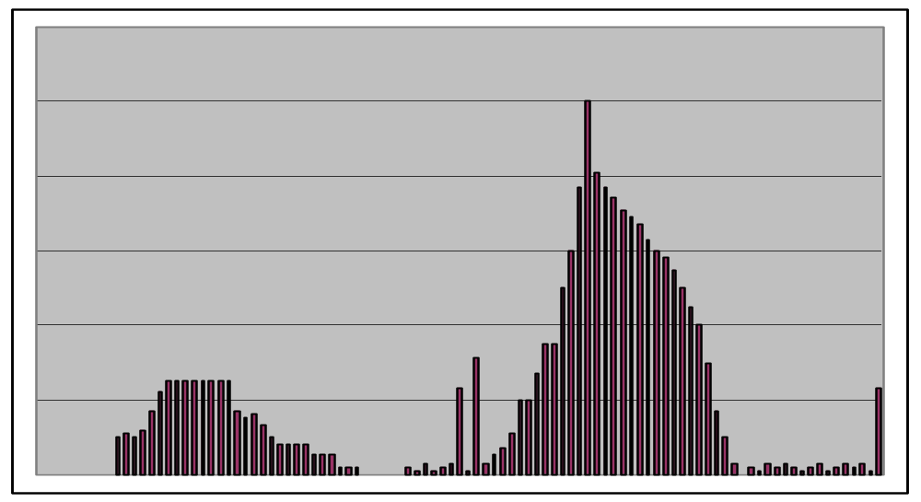
Image Histograms
The histogram of an image shows us the distribution of grey levels in the image
Massively useful in image processing, especially in segmentation
Frequencies
Grey Levels

Slide 5
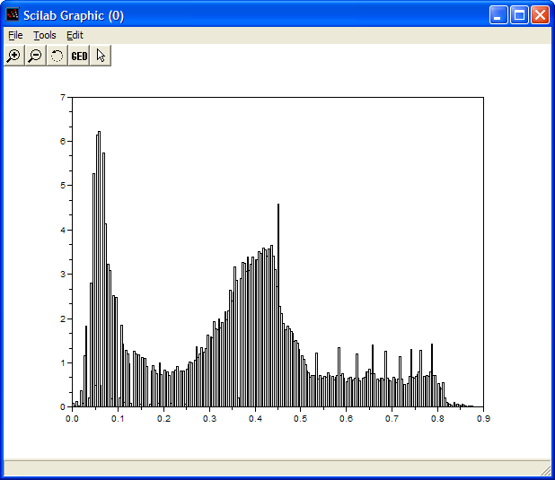
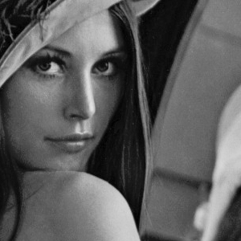

Histogram Examples (cont…)
Images taken from Gonzalez & Woods, Digital Image Processing (2002)

Slide 6
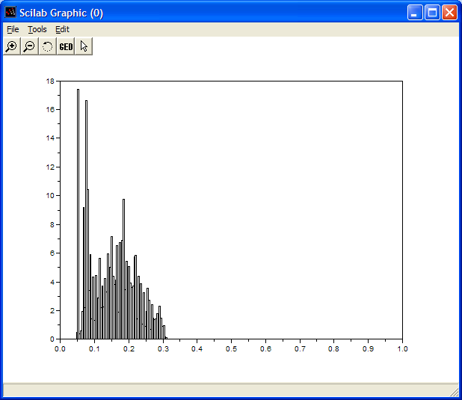
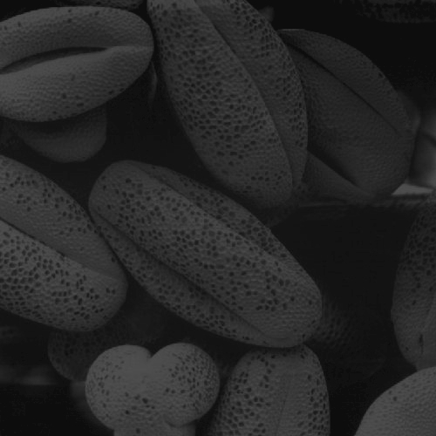
Histogram Examples (cont…)
Images taken from Gonzalez & Woods, Digital Image Processing (2002)

Slide 7
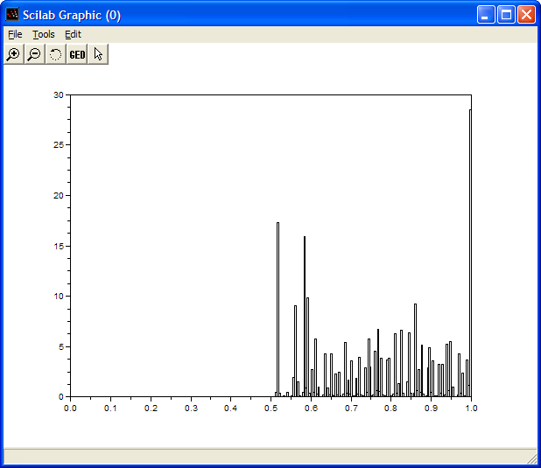
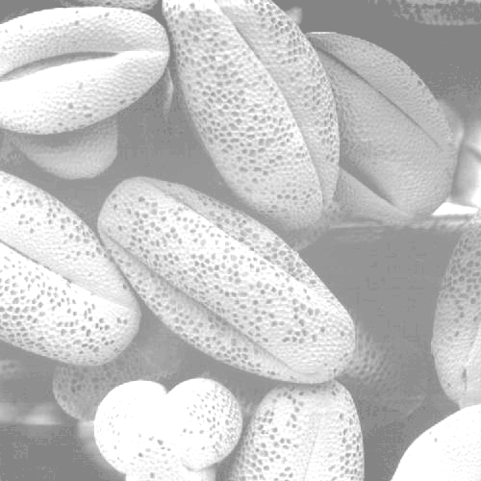
Histogram Examples (cont…)
Images taken from Gonzalez & Woods, Digital Image Processing (2002)

Slide 8
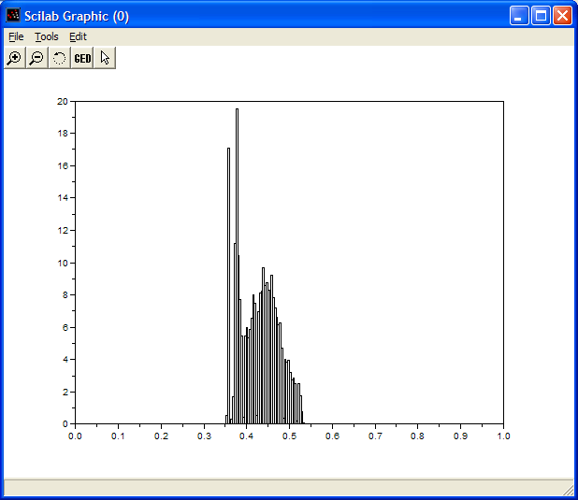

Histogram Examples (cont…)
Images taken from Gonzalez & Woods, Digital Image Processing (2002)

Slide 9
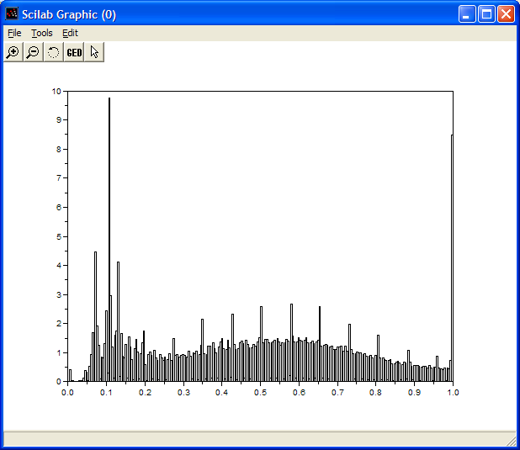
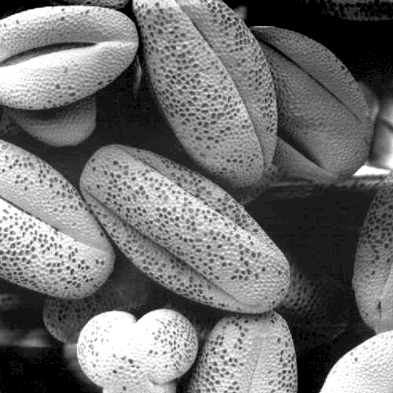
Histogram Examples (cont…)
Images taken from Gonzalez & Woods, Digital Image Processing (2002)

Slide 10
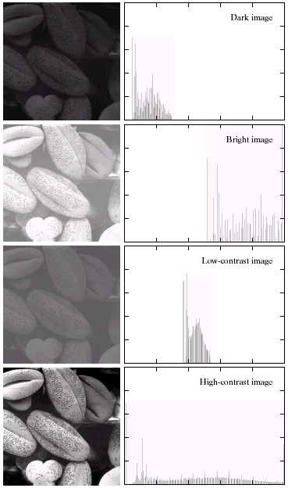
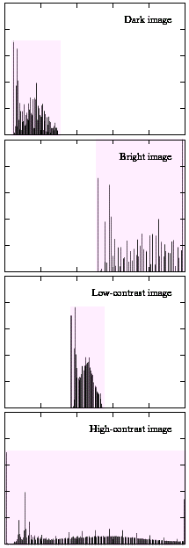
Histogram Examples (cont…)
A selection of images and
their histograms
Notice the relationships
between the images and
their histograms
Note that the high contrast
image has the most
evenly spaced histogram
Images taken from Gonzalez & Woods, Digital Image Processing (2002)

Slide 11
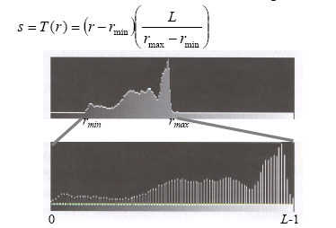
Contrast Stretching through Histogram
C
If r_{max} and r_{min} are the maximum and minimum gray level of the input image and L is the total gray levels of output image The transformation function for contrast stretching will be

Slide 12
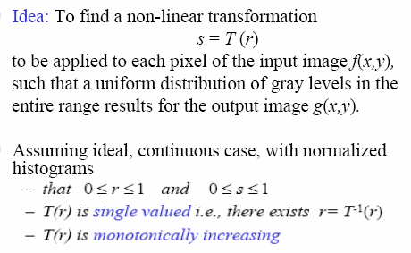
Histogram Equalization

Slide 13
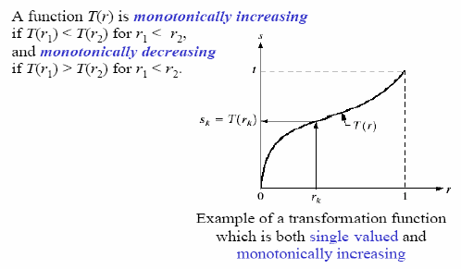
Histogram Equalization

Slide 14
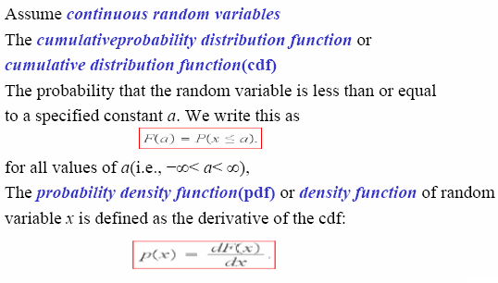
Background (Probability Distribution)

Slide 15
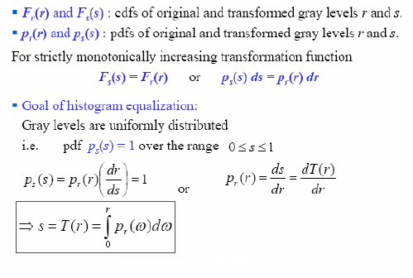
Histogram Equalization

Slide 16
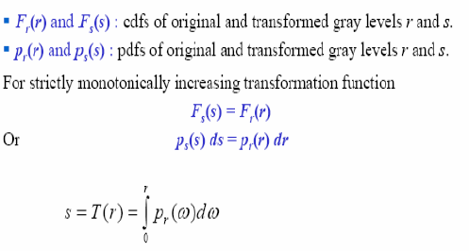
Histogram Equalization

Slide 17
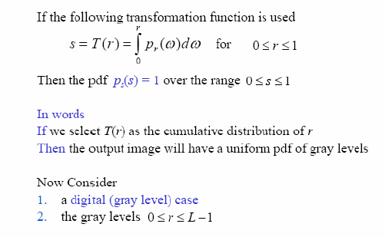
Histogram Equalization

Slide 18
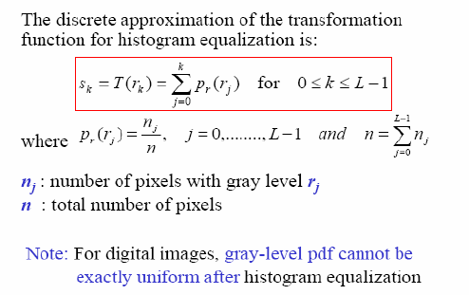
Histogram Equalization

Slide 19
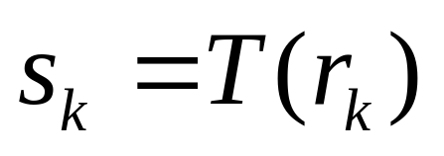
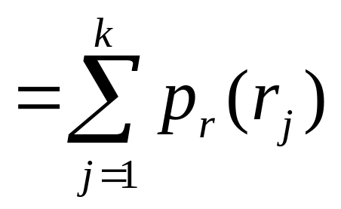
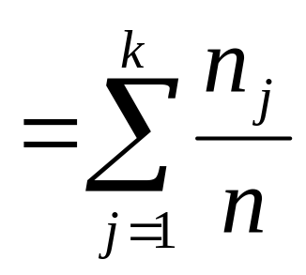
Histogram Equalisation(Summary)
Spreading out the frequencies in an image (or equalising the image) is a simple way to improve dark or washed out images
The formula for histogram
equalisation is given where
  r_{k}: input intensity
  s_{k}: processed intensity
  k: the intensity range
  (e.g 0.0 – 1.0)
  n_{j}: the frequency of intensity j
  n: the sum of all frequencies

Slide 20
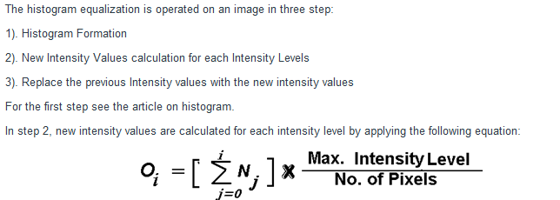

Slide 21
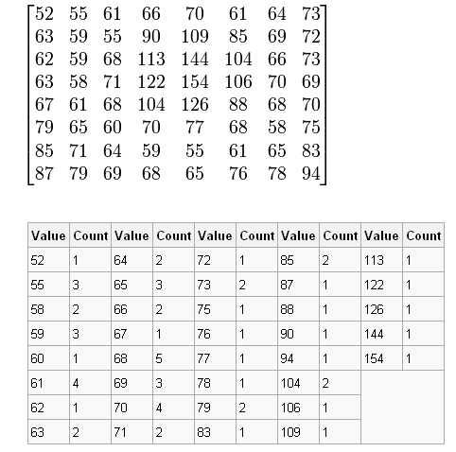
Example

Slide 22
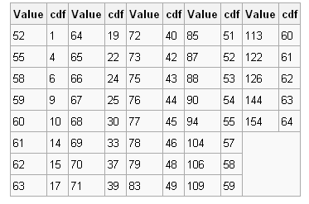
Example: cdf

Slide 23
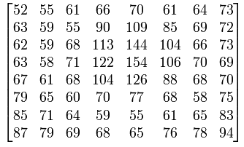
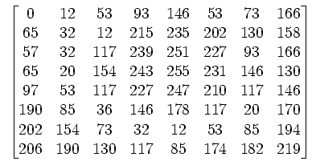
Example
Initial Image
Image After Equalization
Notice that the minimum value (52) is now 0 and the maximum value (154) is now 255.

Slide 24
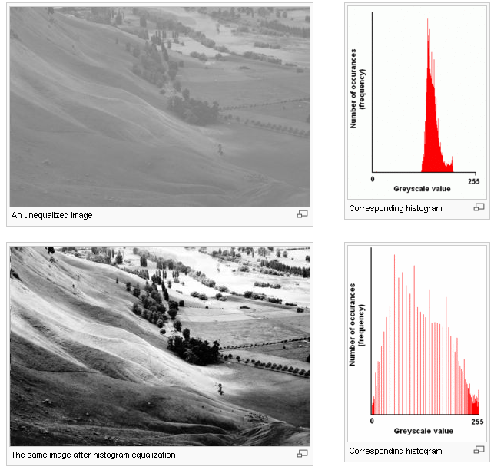
Example

Slide 25
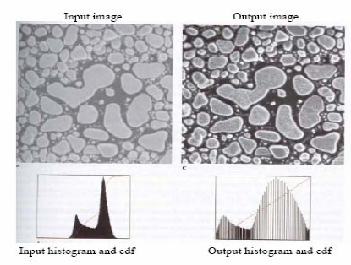
Histogram Equalization-Examples

Slide 26
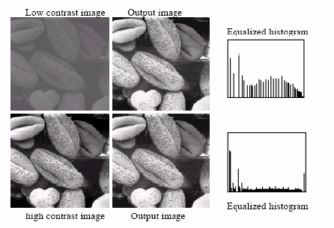
Histogram Equalization-Examples

Slide 27
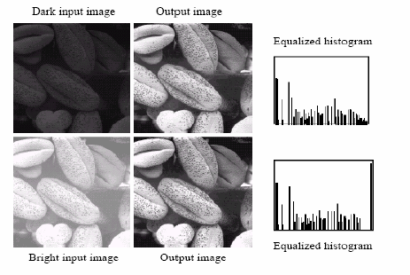
Histogram Equalization-Examples

Slide 28
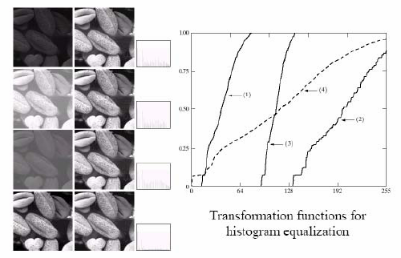
Histogram Equalization-Examples

Slide 29
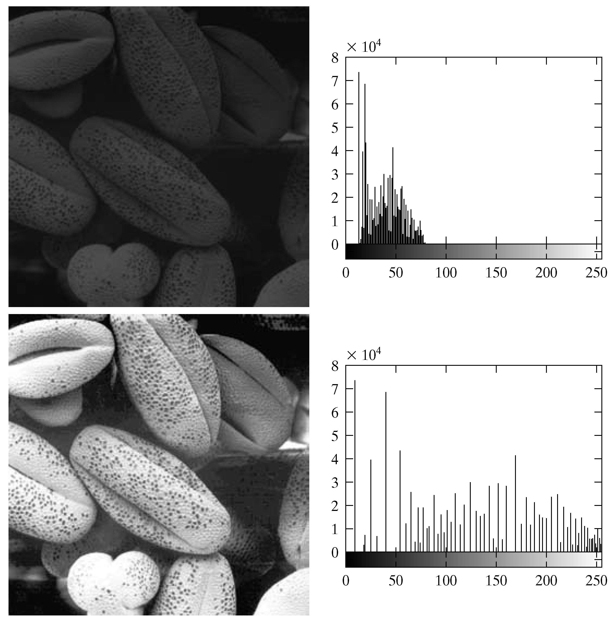
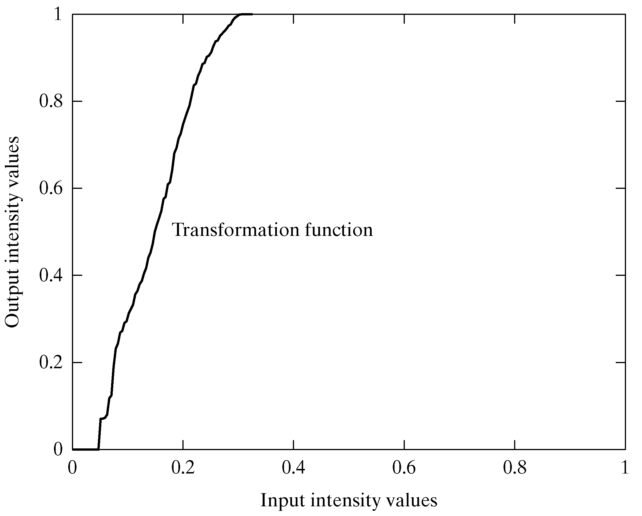
Equalisation Transformation Function
Images taken from Gonzalez & Woods, Digital Image Processing (2002)

Slide 30
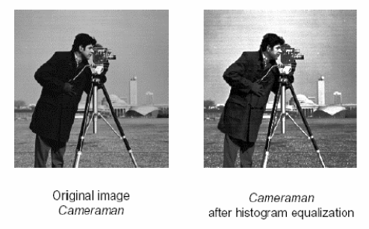
Histogram Equalization-Examples

Slide 31
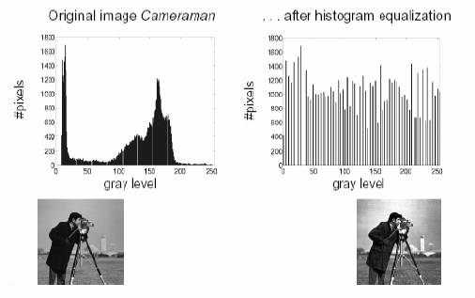
Histogram Equalization-Examples

Slide 32
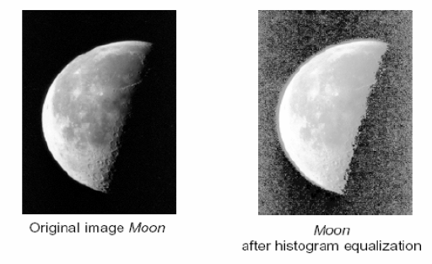
Histogram Equalization-Examples

Slide 33
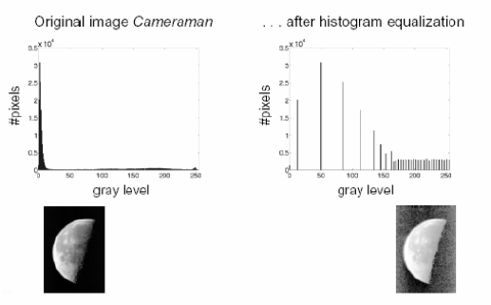
Histogram Equalization-Examples

Slide 34
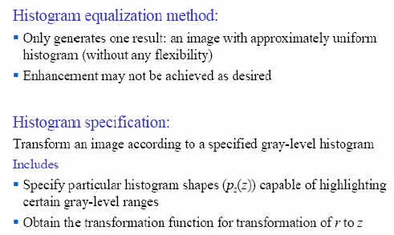
Histogram Specification/Matching

Slide 35
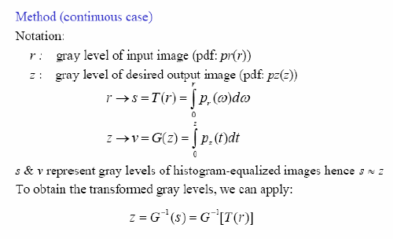
Histogram Specification/Matching

Slide 36
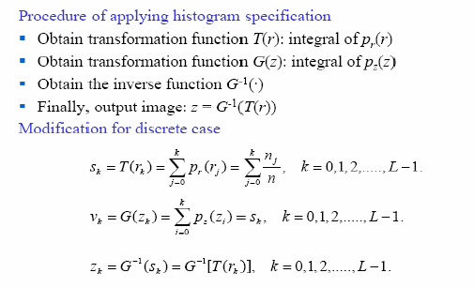
Histogram Specification/Matching

Slide 37
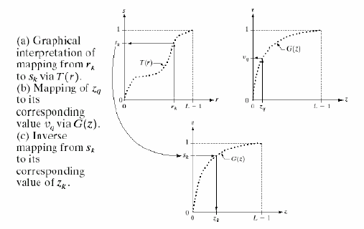
Histogram Specification/Matching

Slide 38
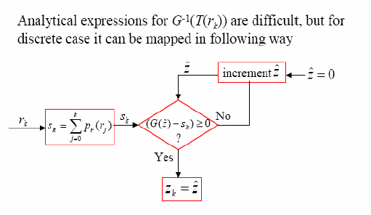
Histogram Specification/Matching

Slide 39
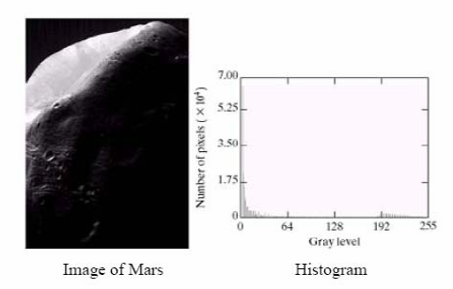
Histogram Matching Example

Slide 40
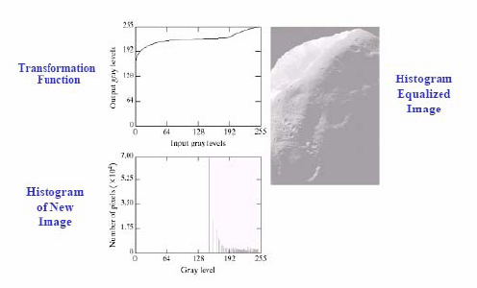
Histogram Matching Example(continued)

Slide 41
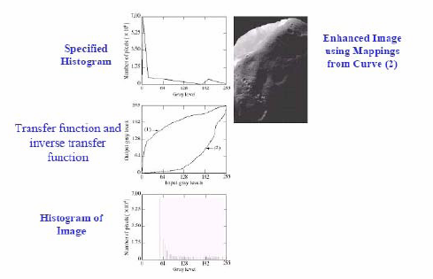
Histogram Matching Example (continued)

